Slide 1
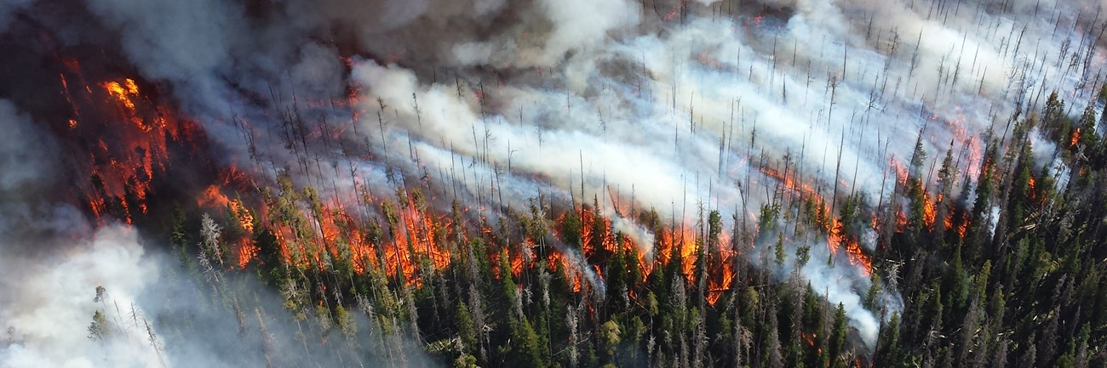
Forest Fires
INFO 450 Final Project Connor Delony

Slide 2
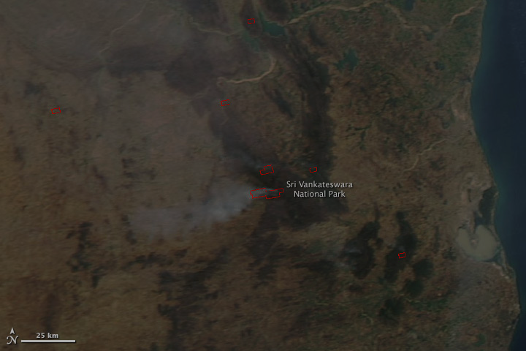
Problem
Forest fires have been a big problem in the United States
2023 # of fires: 11,000 Acres burned: 351,821
2022 # of fires: 7,000 Acres burned: 834,238
2021 # of fires: 10,000 Acres burned: 438,525
2017 # of fires: 17,000 Acres burned: 2,229,561

Slide 3
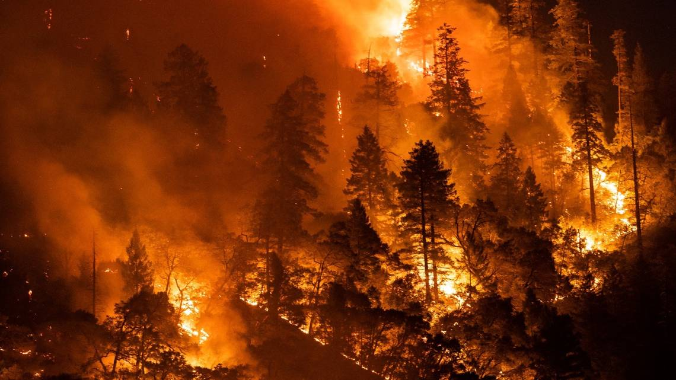
Why did I chose this topic?
I chose to work on this project because forest fires are becoming more and more common and we need to bring more attention to stopping them.

Slide 4
Progress
First, I made some visualizations to see the data on when forest fires are more likely to happen.
Next, I went through the data to see how the different variables affected each other.
Challenges:
Main challenge was figuring out how to deal with missing data and how I could manipulate it so it could work for my model.

Slide 5
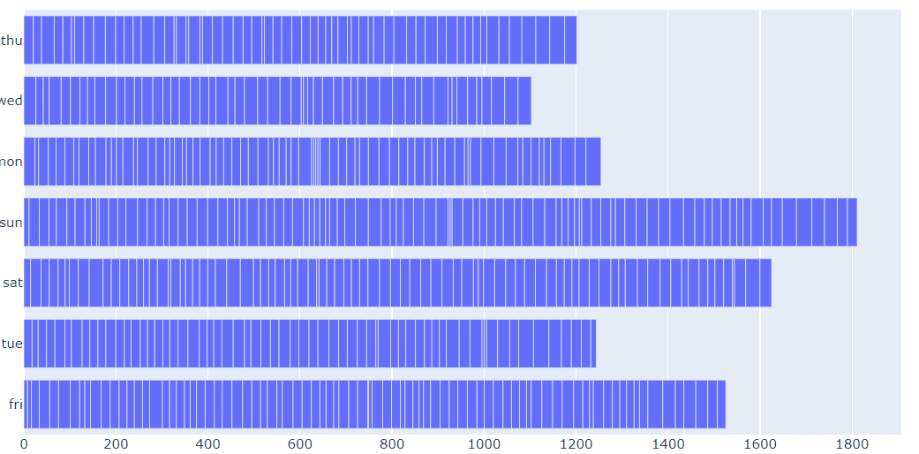
Days of the week of temperature

Slide 6
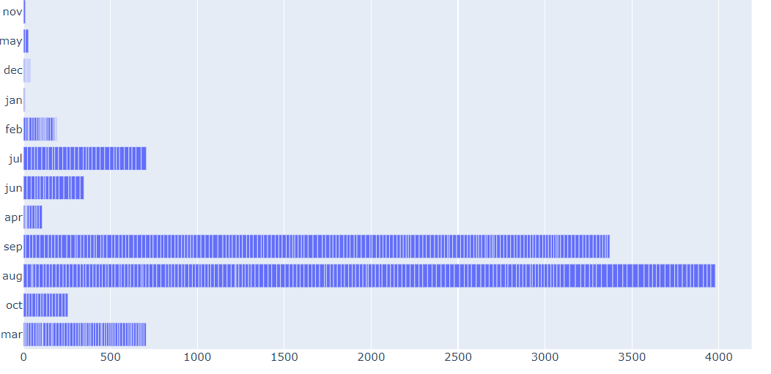
Months and their average temperatures

Slide 7

Findings
Through my analysis of the data set I found that the main influence of forest fires is the temperature. Which supports existing theories on forest fires.
Months and the various seasons have a huge factor on the number of fires.
Wind and rain also can factor in to how many fires there are
Machine Learning Model
I would say my model could have some potential but it could still be improved a lot

Slide 8
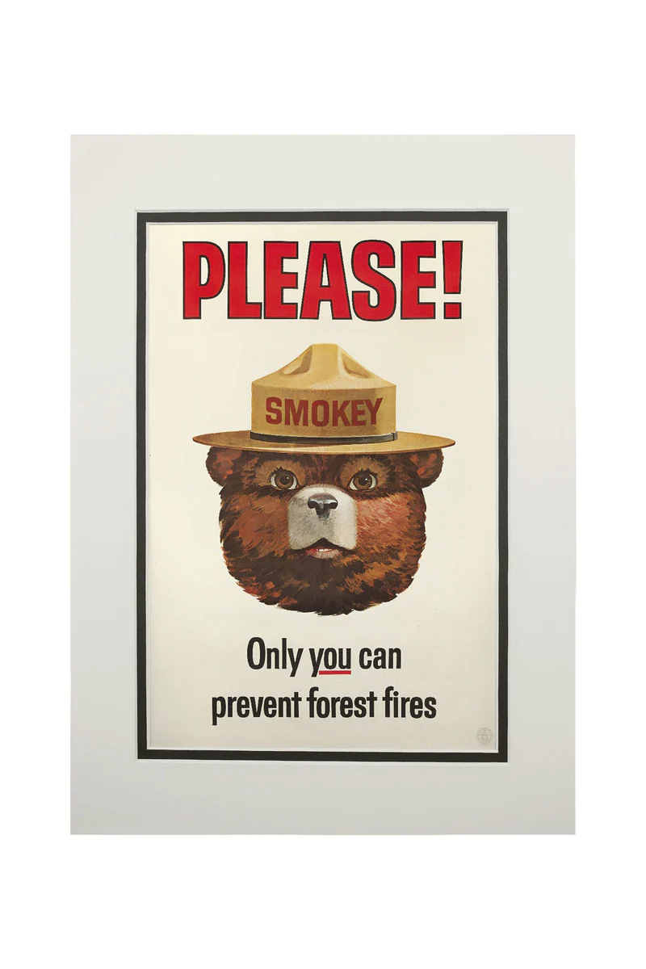
Recommendations
More ad campaigns
Better technology for predicting fires early
Make stricter penalties for arson
Better forest management

Slide 9
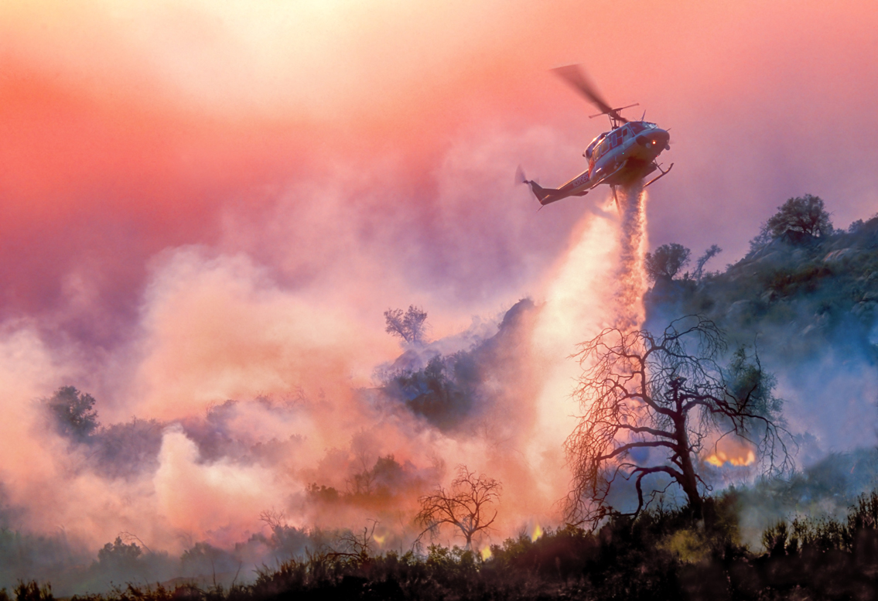
Future Work
Have a more widened area and a longer time period for the data set.
Use more factors on what could affect forest fires. For example: weather patterns and land use.

